Slide 1

Ecological Metadata Language
Metadata Standards

Slide 2
Metadata standards
OBIS (and GBIF) uses the Ecological Metadata Language (EML), in more particularly the GBIF EML profile (version 1.1), as its metadata standard.
The Integrated Publishing Toolkit (IPT) developed by GBIF provides an online interface to manually fill in the EML terms.
OBIS Manual: https://obis.org/manual/eml
Notes:
OBIS (and GBIF) uses the Ecological Metadata Language (EML), in more particularly the GBIF EML profile (version 1.1), as its metadata standard. EML has moved leaps and bounds beyond 1.1 (v2.2 released in September 2019) but the GBIF profile split off from it in 2014 or so and it hasn’t been tracking alongside the current EML standard.
The Integrated Publishing Toolkit (IPT) developed by GBIF provides an online interface to manually fill in the EML terms via webform and generate a eml.xml file that is compliant.
This metadata is concerned with discovery, and attribution, it’s what populates the flashy dataset pages on the OBIS website, and how we register who funded, collected, curated, published, and were the primary users of each dataset.

Slide 3
Metadata standards
EML TERMS
Title
Abstract
Contact
Citation
geographicCoverage
temporalCoverage
taxonomicCoverage
purpose
methods (study extent, sampling, QC, step description)
project
keywords
Summary of the intentions for which the data set was developed. Includes objectives for creating the data set and what the data set is to support.
Required by OBIS
https://gcmd.earthdata.nasa.gov/KeywordViewer/
Notes:
For submitting to OBIS, the following 4 terms are the bare minimum: Title, Citation, Contact and Abstract.
These and other terms are prompted in the IPT Metadata form set that accompanies each data collection, with entire sections covering geographic, temporal, and taxonomic coverage. Some of these fields are very straightforward, almost all of them have tooltips baked into the IPT to help with context.
The Methods section particularly is an avalanche of free text, but allows for you to relay documentation you might receive from the data generators on the specific step by step processes that were part of the study that designed, executed, curated, and processed the dataset.
Project data lets you document the central organization or larger effort behind this dataset’s generation and more high-level things like the motivation for th eproject, how it was funded, details of the study area and here there may or may not be some overlap with study design. You can make personnel entries attached to this, a name and a role, and the personnel directory and identifier, for instance ORCID, Google Scholar ID, researcherID, or even LinkedIn
And finally there’s a section for keywords that lets you include keywords you want to associate with the dataset and optionally which vocabulary you are pulling those keywords from, for instance the Global Change Master Directory is a popular vocab for this field, they have a Earth Science - > Biological Classification section that may provide more relevant eyeballs to the dataset. There’s a browser for GCMD here, but it’s by no means the only thing you may want to use in the Keywords fieldset. Multiple different keywords sets are allowed to be associated in the metadata, so I would approach this with ‘how do I get the most people possible to find this dataset’

Slide 4
Metadata standards
Shortname Resource identifier in the IPT, will be part of the URL. Short! No escape characters please!
Dataset title Is different from the shortname.
A good, descriptive title is indispensable
Provides users with valuable information, making e.g. data discovery / screening easier
Originally received | Recommended title, to be checked with provider
Biomôr | Benthic data from the Southern Irish Sea from 1989-1991
Kyklades | Zoobenthos of the Kyklades (Aegean Sea) from a survey in 2009
Benthos_NS | The macrobenthos of the North Sea
Dataset_1 | Meiofauna of Madagascar
Dataset_for_OBIS | Fish collected during a 3-month survey in the national waters of South Africa in 1975
…
Notes:
The IPT requires you to provide a Shortname. Shortnames serve as an identifier for the resource within the IPT installation (so should be unique within your IPT), and will be used as a parameter in the URL to access the resource via the Internet. The convention is to use only alphanumeric characters, hyphens, or underscoresm so no spaces, and no special characters or marks. E.g. largenet_im in http://ipt.vliz.be/eurobis/resource?r=largenet_im. After creating a new dataset resource, the field title will be filled out with the short name you provided earlier. Please make sure you provide a dataset title following the guidelines below.
Dataset titles provided to OBIS node managers are often very cryptic, such as an acronym, and often only understandable by the data provider. However, to increase the discoverability and be useful for a larger audience, the dataset title should be as descriptive and complete as possible. OBIS recommends titles to contain information about the taxonomic, geographic and temporal coverage. If the dataset title does not meet these criteria and you believe the title should be changed, then contact the data provider with a suggestion or ask for a more descriptive title. If the dataset has already been published (made publicly available) - and therefore known by that title elsewhere, then the same title should be kept (even if it would not meet the proposed guidelines)! Changing the title of an already published dataset cannot be done, as this will generate confusion and possible duplicates in systems like OBIS or GBIF in a later stage.
The acronym or working title could still be documented in the metadata, so there is no confusion about how the full title is linked to the originally provided acronym or working title.

Slide 5
Metadata standards
Abstract
The abstract or description of a dataset provides basic information on the content of the dataset. The information in the abstract should improve understanding and interpretation of the data.
It is recommended that the description indicates whether the dataset is a subset of a larger dataset and – if so – provide a link to the parent metadata and/or dataset.
If the data provider or OBIS node require bi- or multilingual entries for the description (e.g. due to national obligations) then the following procedure can be followed:
Indicate English as metadata language
Enter the English description first
Type a slash (/)
Enter the description in the second language
Example
The Louis-Marie herbarium grants a priority to the Arctic-alpine, subarctic and boreal species from the province of Quebec and the northern hemisphere. This dataset is mainly populated with specimens from the province of Quebec. / L’Herbier Louis-Marie accorde une priorité aux espèces arctiques-alpines, subarctiques et boréales du Québec, du Canada et de l’hémisphère nord. Ce jeu présente principalement des spécimens provenant du Québec.
Notes:
Brief description of the data resource. If you are providing a subset or a generalization / averaging of the complete source data, you can flag it here and also in dataGeneralizations
Bilingual abstracts can be supported with this procedure
The newer versions of the EML schema have more accommodation for multilingual abstracts, taking advantage of the attributes in the XML to denote language. this could be a development request, or could be part of a can of worms

Slide 6
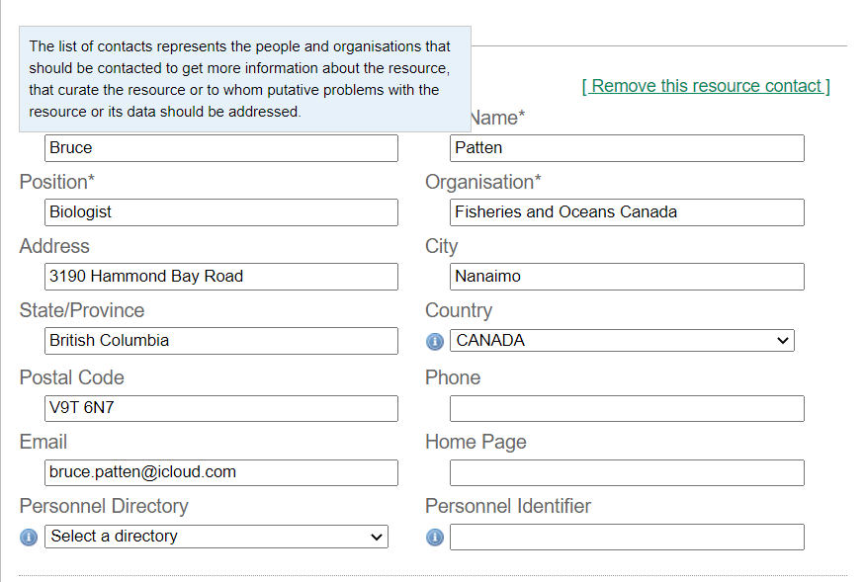
Metadata standards
Contact
Publisher (institution)
Contact (person + institution)
Creator (person + institution)
Associate party (person + institution)
Originator
Content provider
Principle investigator
Custodian steward
Owner
Point of contact
..
Notes:
The resource contact is the person or organization that curates the resource and who should be contacted to get more information or to whom questions with the resource or data should be addressed. Although a number of fields are not required, it is strongly recommend to provide as much information as possible, and in particular the email address. This will also be the contact information that appears on the OBIS metadata pages.
The resource creator is the person or organization responsible for the original creation of the resource content. When there are multiple creators, the one that bears the greatest responsibility is the resource creator, and other people can be added as associated parties with a role such as ‘originator’, ‘content provider’, ‘principle investigator’, etc.
Possible functions/roles:
Originator (person/organization that originally gathered/prepared the dataset)
Content provider (principal person/organization that contributed content to the dataset)
If you’re building EML via the IPT you’ll see pre-created forms for the few roles they want you to fill out by default, and the option to add more personnel and roles below those. Each role lays out name, position, org, contact info, plus a Personnel Directory/Identifier dropdown

Slide 7
Metadata standards
{dataset.authors} ({dataset.pubDate}) {dataset.title}. [Version {dataset.version}]. {organization.title}. {dataset.type} Dataset {dataset.doi}, {dataset.url}
Platt T (2013): MEL: Marine cladocera collected from St. Margarets Bay between May to November, 1967-1969. v1.5. Canadian node of the Ocean Biogeographic Information System (OBIS Canada). Dataset/Occurrence. http://ipt.iobis.org/obiscanada/resource?r=smb_cladocera_tr698&amp;v=1.5
Citation
Comparable to a publication reference
Should contain:
Authors (e.g. data collectors, responsible researchers, data managers, …)
Publication year
Dataset title
Name of the organizations involved when different from publisher
Publisher (can be the OBIS node)
Dataset type (e.g. occurrence, sampling event)
Version number
IPT dataset url
Notes:
Citations
The dataset citation allows users to properly cite the datasets in further publications or other uses of the data.
A dataset citation is different from the data source citation (in case the data is digitized from a publication), and these references can be added to the additional metadata. A dataset citation can have the same format of a journal article citation, and should include the authors (contact, creator, principle investigator, data managers, custodians, collectors…), the title of the dataset, the name of the data publisher (or custodian institute), and the access point URL to the resource.
There’s a citation generator built into the GBIF IPT that you can turn on or off. Citations include a version number for datasets that get updated continually, and can also include a Citation Identifier, so a DOI/or other persistent universal resource identifier, that will resolve to some external resource. You can supply your own format for citation but I don’t believe they will let you template it yet using other variables in the metadata. Also, if you supply your own citation format, when it’s published to GBIF, that gets replaced with the auto-citation on the gbif.org dataset pages. For them, it’s a matter of standardization over customization, but they’ve left a line open at the GBIF helpdesk for people who truly cannot abide this, and must provide a specific citation profile.
Here’s the formula the citation generator uses, and here’s an example of how that works in practice.

Slide 8
Metadata standards
Data paper
Fill in as much metadata as possible and publish your metadata as a data paper e.g. in a Pensoft journal, by importing the eml.xml file into their arpha tool.
Instructions: https://arpha.pensoft.net/tips/From-GBIF-IPT-metadata-EML
Notes:
So, we won’t do this just yet, but it’s worth highlighting that even despite the version mismatch, due to the two platforms having a shared understanding of EML we can take a dataset that’s been published on an IPT, and register it with a Pensoft journal as a ‘data paper’, simply by exporting the EML and importing it to the appropriate Pensoft journal of our choice.

